Slide 1
CutMix: Regularization Strategy to Train Strong Classifiers with Localizable Features
Sangdoo Yun Dongyoon Han Seong Joon Oh Sanghyuk Chun
Yonsei University , Seoul
ICCV 2020
2019-05-13

Slide 2
1
Overview
Contents
Problem
Experiments
Conclusion
Inspiration
Scheme
Future
Regional dropout
Binary Rectangular mask
CutMix
Bounding box
Object localization
Cropped area ratio
Keywords
Uniform distribution

Slide 3
2
Problem

Slide 4
3
Inspiration

Slide 5
4
Scheme

Slide 6
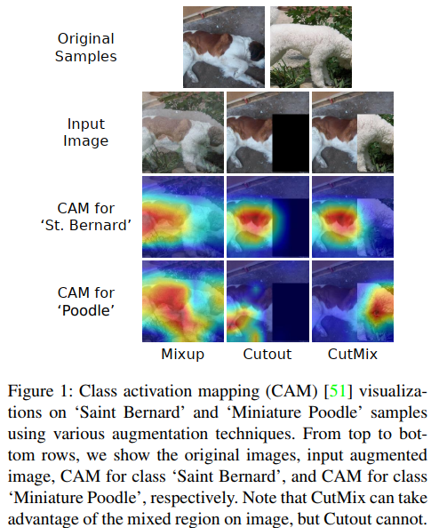
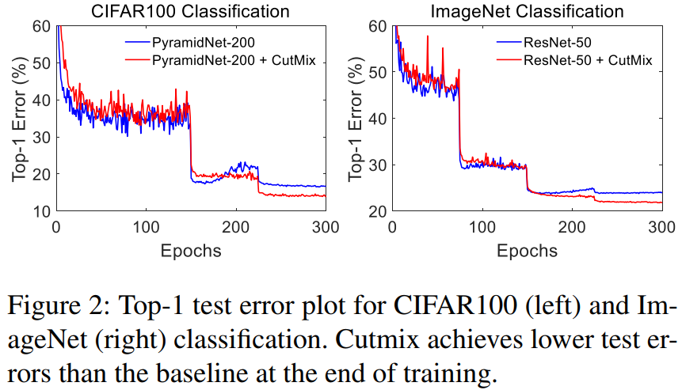
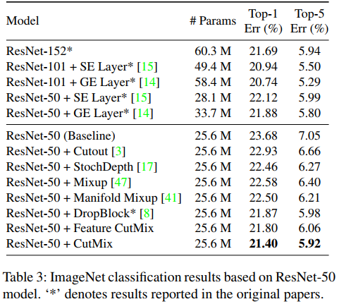
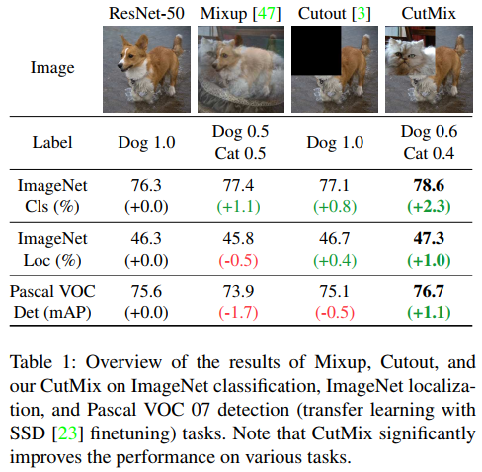
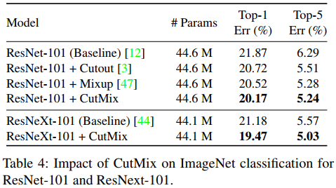
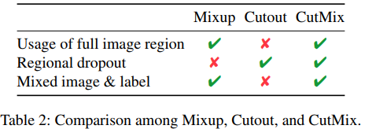
5
Experiments

Slide 7
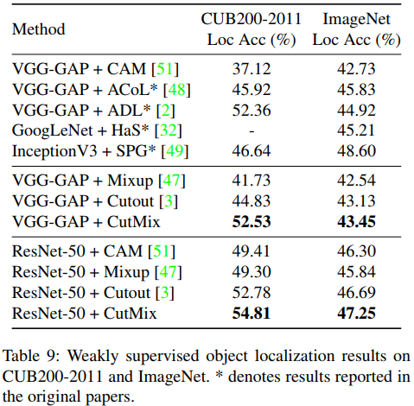
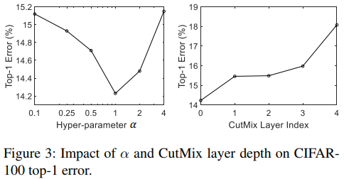
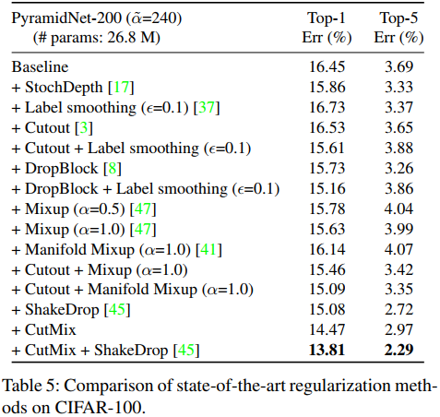
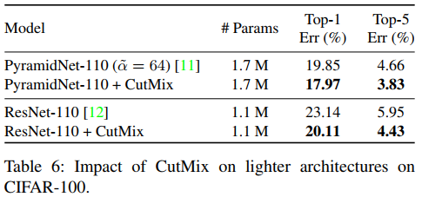
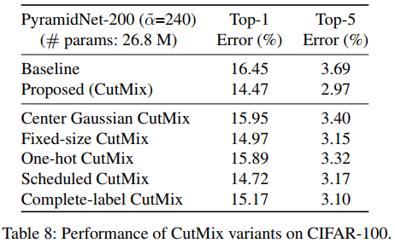
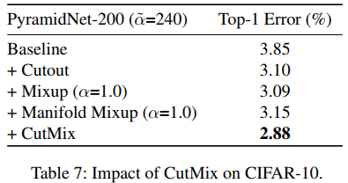
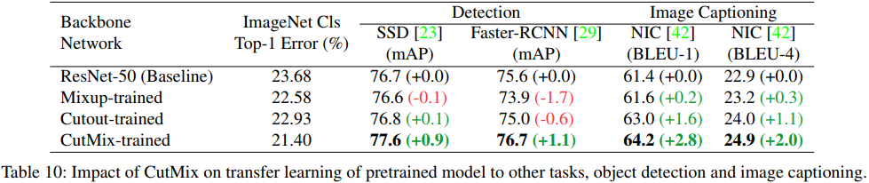
5
Experiments

Slide 8
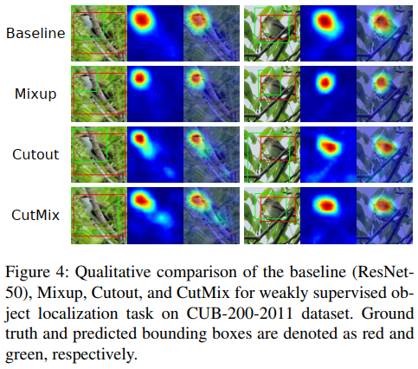
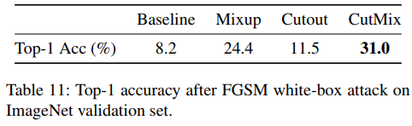
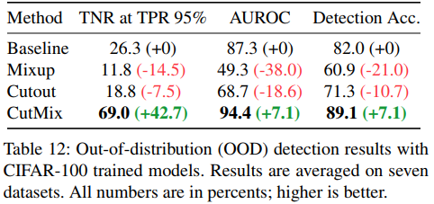
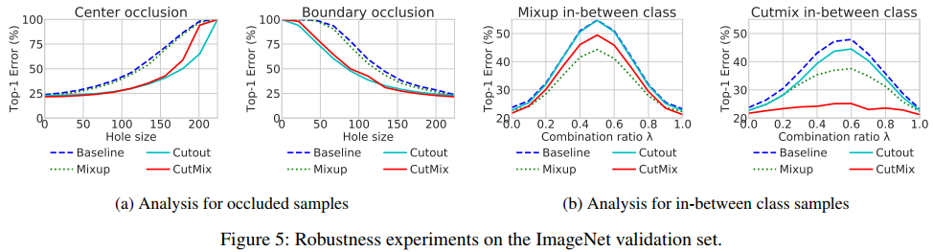
5
Experiments

Slide 9
7
Conclusion

Slide 10
8
Future

Slide 11



Thank you !
Mengdie Huang
Group AI Security
Lab Ruiyun
2020-10-08

